Slide 1
Spot On!

Slide 2
Find the noun in the sentence
The rabbit is hungry.

Slide 3
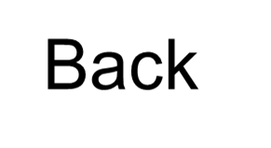
Find the noun in the sentence
The rabbit is hungry.
Try again!

Slide 4
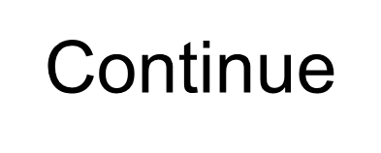
Find the noun in the sentence
The rabbit is hungry.
Spot on!

Slide 5
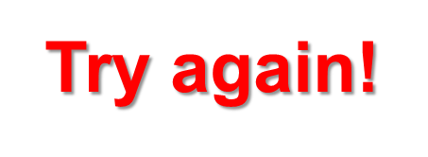
Find the noun in the sentence
The rabbit is hungry.

Slide 6
Find the noun in the sentence
The rabbit is hungry.

Slide 7
Find the noun in the sentence
And so on…

